Slide 1

Bikeshare Siting Improvements
Hannah DeBruin
Weekly Meeting: Transit Data Subgroup
12/07/22

Slide 2
Weighting Update – Supply/Demand Factors
Supply (Existing Infrastructure, Benefits for Operations/Maintenance, Cost Savings) | Demand (Trip Generation Factors, Value to System Users)
Proximity to Bike Facilities | Household Density
Major Employment Campuses | Student Dorm Locations
 | Commercial Parcel Proximity
Recreation Facilities | Recreation Facilities
Proximity to K-12 Schools | Proximity to K-12 Schools
Proximity to Transit Stops | Proximity to Transit Stops
Weekly Meeting (12/07/2022)
Hannah DeBruin

Slide 3
Supply/Demand Factors
How important is cost efficiency versus level of service?
Which factors are most important to demand/level of service?
Which factors are most important to supply/cost efficiency of construction and maintenance?
Factor 1
Factor 2
Factor 3
Factor 4
Factor 5
Factor 6
Weekly Meeting (12/07/2022)
Hannah DeBruin

Slide 4
Supply/Demand Factors
How important is cost efficiency versus level of service?
Which factors are most important to demand/level of service?
Which factors are most important to supply/cost efficiency of construction and maintenance?
Factor 1
Factor 2
Factor 3
Factor 4
Factor 5
Factor 6
Weekly Meeting (12/07/2022)
Hannah DeBruin

Slide 5
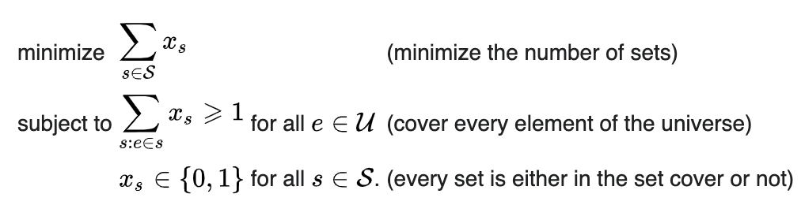


Set Cover Problem
(weighted by cost)
Weekly Meeting (12/07/2022)
Hannah DeBruin
Notes:
greg lindsey
public transit planning (avi ceder)

Slide 6
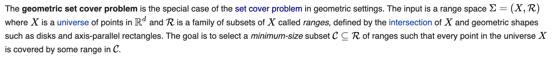
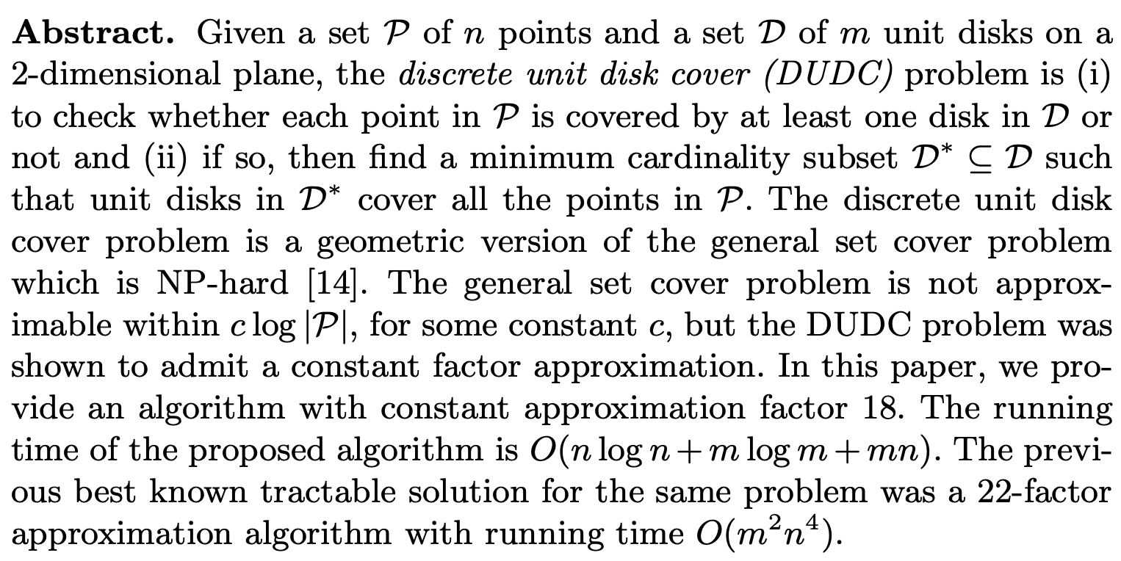
Geometric Set Cover Problem
Discrete unit disc cover problem -
Weekly Meeting (12/07/2022)
Hannah DeBruin

